Slide 1
Shine Your Light
Georgia Council of Administrators of Special Education
November 15, 2023

Slide 2
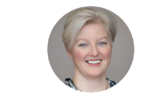
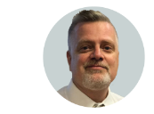
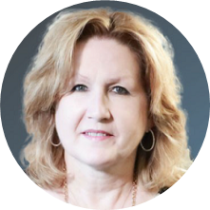
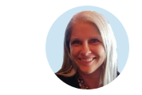
Office of Federal Programs - Mission
The mission of the Office of Federal Programs is to provide technical assistance, program monitoring, and resources to local educational agencies (LEA) to ensure that all children have an opportunity to obtain a high-quality education and to achieve proficiency on the state's high academic achievement standards.
Shaun Owen
Deputy Superintendent
John Wight
Associate Superintendent
Wina Low
State Director – Special Education
Kathleen Yarbrough
State Director –
ESSA Programs

Slide 3
Thank You, G-CASE!
Shine On!

Slide 4
Speed of Light
Einstein's theory of special relativity tells us the speed of light is 186,000 miles per second.
Speed of light is a constant independent of motion or source.
Light is a million times faster than a bullet.

Slide 5
Sunflower Field

Slide 6
To Light the Way

Slide 7
We’ll Leave the Light On.

Slide 8
This little light of mine, I’m gonna let it shine.

Slide 9
Shine On
Your light is your legacy. Make it a bright one. – Unknown
The world needs your light. -Unknown
Let your brilliance shine and inspire others to do the same. - Unknown
Let your light shine. - Unknown
Light the way for others. - Unknown
You are allowed to shine! - Unknown
“When you let your light shine, you unconsciously give others permission to do the same.” – Nelson Mandela

Slide 10
Shine a Light on increased outcomes for students with disabilities
Teacher and Leader Retention
Special Education Leadership Development Academy
Special Education School Administrators Academy
Instructional Supports

Slide 11
Shining a Light on Professional Learning and Continuous Improvement
Specially Designed Instruction
Transition
General Supervision
Speech/ Language
Literacy
Dyslexia
Budget
Data Reporting
Discipline
GAA 2.0 – Requesting Feedback
FBA/BIP
Vision and Hearing Updates

Slide 12
Working with the American Institutes of Research to develop high-quality modules.
Ready and on-demand resources
Transition
Prior Written Notice
Preschool Special Education
Present Levels of Performance
Specially Designed Instruction
Plus 2 more to be determined

Slide 13
Thank you for supporting the Back to Basics Series
Back to Basic | Location | Number of Participants
Behavior--8-23-2023 | Athens- Region 5 | 30
Behavior – 9-13-2023 | Cleveland- Region 3 | 62
Transition- 09-18-2023 | West Central GLRS- Region 2 | 23
Behavior- 9/25/2023 | Dublin- Region 13 | 25
Behavior - 9/27/2023 | Warner Robins- Region 8 | 41
Transition- 10-5-2023 | North Central GLRS- Region 2 | 47
IEP- 10-05-2023 | Costal Plains RESA- Region 17 | 65
IEP- 10-19-2023 | First District RESA- Regions 14 & 15 | 85
Transition- 10-20-2023 | Southwest Georgia GLRS- Region 16 | 67
IEP- 10-23-2023 | Northwest GLRS Lakeview Auditorium- Region 1 | 48
IEP- 11-8-2023 | Pioneer RESA- Region 3 | 83
Transition- 11-9-2023 | East Central GLRS- Region 13 | 48
IEP- 11-30-2023 | Central Georgia- Region 8
IEP- 12-5-2023 | CSRA RESA- Region 10
Transition- 12- 7-2023 | GaDOE- 10th Floor West Tower- Regions 4a&4b
Transition- 1-10-2024 | South Central GLRS
Transition- 1-18-2024 | Northeast GLRS- Region 5
As of November 13, 2023,
624 participants.

Slide 14
Retaining Special Education Personnel at All Levels: Georgia's Approach

Slide 15
Teacher Retention: Georgia’s Approach
Conference Presentations
OSEp Leadership Conference
CEEDAR Convening
Education Commission of States
National Association of Special Education State Directors
Articles and Articles
Council of Chief State School Officers,
Education Commission of States
Numerous webinars
Council for Exceptional Children
Office of Special Education programs
CEEDAR
American Institutes of Research Thought Leaders

Slide 16
Thank you, GLRS!

Slide 17
Today’s Educator Workforce
New teachers who are poorly supported or underprepared are more likely to leave the profession within the first five years.
Students are more likely than ever before to be placed in classrooms with new teachers.
about one in five teachers in U.S. classrooms are in their first three years
many teachers are now entering through an alternative certification program.

Slide 18
Induction as a Retention Strategy
The quality of induction for novice special educators is a powerful predictor of their intention to stay in their schools.¹
Practitioners indicated strong mentorship and induction in early career as the most effective method of improving teacher retention.²
¹Billingsley, B., & Bettini, E. (2019). Special Education Teacher Attrition and Retention: A Review of the Literature. Review of Educational Research, 89(5), 697–744. https://doi.org/10.3102/0034654319862495
²Fowler, S. A., Coleman, M. R. B., & Bogdan, W. K. (2019). The State of the Special Education Profession Survey Report. TEACHING Exceptional Children, 52(1), 8–29. https://doi.org/10.1177/0040059919875703

Slide 19
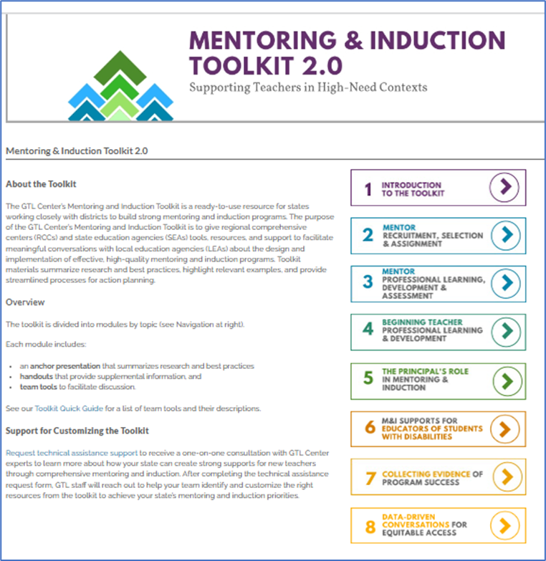
High-Quality Mentoring and Induction Practices
https://gtlcenter.org/technical-assistance/toolkits/mi-toolkit

Slide 20
Georgia Teacher/Provider Retention Program (TPRP)
The purpose of this project is to improve the retention of special education teachers and early intervention providers in Georgia – Part B and C.
USED Office of Special Education Programs Grant
Awarded $500,000 per year for up to five years

Slide 21
Special Education Teacher Retention Data
In 2019, Georgia had 3,400 vacancies in special education teacher positions.
Between 2018 and 2020, Georgia hired 1,235 new special education teachers and lost approximately the same number of special education teachers.
A large proportion of Georgia’s teacher workforce is within their first three years of their teaching career.
Is it a teacher shortage or a retention crisis?
www.teachgeorgia.org
Notes:
Meaning the gap in the number of vacancies and number of hires has not narrowed.
Often a challenge for a field with high turnover and limited numbers of teachers

Slide 22
Retention is the New Recruitment!
How do we keep our teachers?

Slide 23
High Leverage Practices

Slide 24
AVATAR Lab
Regional GLRS directors and coaches learn how to use Mixed Reality Simulation and existing HLP resources to design and utilize professional learning experiences for induction teachers.
New special education teachers and directors practice complex and difficult conversations with teachers and leaders.

Slide 25
The Georgia Teacher/Provider Retention Program (GA-TPRP) Part B (K-12)
1. Develop a pool of competent instructors/coaches (GLRS staff)
2. Provide new teachers professional development, mentoring, and coaching
Train-the-trainer model, including
Facilitator’s guide
Meeting agenda with recommended time allotments
Slide presentation
Professional learning activity handouts
Deliver training to new teachers
Grounded in the high-leverage practices for students with disabilities
Use high-leverage practices self-assessment
Community of Practice
Monthly CoPs to:
Targeted follow up support
Clarifications
Problem solving
Sharing successes
Practice-based opportunities
Create lesson plans using the high-leverage practices
Simulate practice with avatars
On-going Coaching
Coaching guidance
HLP Observation & Coaching Tool; Model Induction Coaching Guidance
Coaching logs

Slide 26
Sample of Partner’s Logo
Notes:
Logos form several of the partners listed in the last four slides.

Slide 27
Induction Program is based on High Leverage Practices HLPs
2021-2022 Six HLPs
2022-2023 Six HLPs
2023-2024 Six HLPs
Add three additional HLPs
Cohort 1 & 2
Notes:
Pay for ebook

Slide 28
Coaching To Support Retention
Leverage discretionary funds to support coaching of induction level teachers participating.
$1,800,000 -$100,000 x 18 GLRS regions

Slide 29
Strategic Coaching Plan
Preparation for Coaches
Delivery of Professional Learning
Delivery of coaching

Slide 30
Goal 1 – Teacher Induction Activities
Annual Performance Report Results (2022-2023)

Slide 31
Percentage of TPRP Participants in Agreement that the TPRP Training and Coaching Increased Their Capacity to Use HLPs in Their Teaching

Slide 32
Percentage of TPRP Participants in Agreement that the Professional Learning (Training, Coaching, MRS Labs) Influenced Their Plans to Continue Teaching

Slide 33
Characteristics of Retained Teachers

Slide 34
Characteristics of Retained Teachers
370 total participants
Completed more than one training or MRS session
Only special education teachers included in retention analyses.

Slide 35
Years Since Certification: 77% of program participants received an initial teaching certificate within the prior three years

Slide 36
2021-2022 Retention Analyses
Percentage of participants retained by variable
* Indicates statistically significant differences

Slide 37
Certified*: Special education teachers who were certified in special education were 48% more likely to be retained than those not certified.

Slide 38
Exceptional Children’s Course: Those who completed the course were 14% more likely to be retained.

Slide 39
High-Need Schools: Teachers in high-need schools were 2% less likely to be retained than teachers not in high-need schools.

Slide 40
Program Completers: Those who completed 75% or more of the Teacher Induction Program were 10% more likely to be retained.

Slide 41
To retain teachers, many factors must be considered.
To have strong teachers, we need to have strong leaders.
Strong leadership is needed to retain teachers.
Retaining special education directors is a priority.
Knowledge of special education by leadership is paramount.

Slide 42
Retaining Special Education Directors
Special Education Leadership Development Academy (SELDA)
Special Education School Administrators Academy (SESAA)

Slide 43
Special Education Leadership Development Academy (SELDA)
Over 20 years of supporting new Special Education Directors
Supports directors with three or less years of experience
Builds capacity for LEAs
Has evolved over the years to what it currently is today
In-Person Sessions
Virtual Sessions
Pre-Conference Sessions

Slide 44
SELDA Training: Quality and usefulness ratings averaged 96% in 2022-2023.

Slide 45
Impact of SELDA Training and Coaching on Skills as a Directors of Special Education or Capacity to Support Directors of Special Education
Average
As a result of the coaching, my skills as a director of special education, or to support out district’s director of special education, have…..
The SELDA training increased my skills as a director of special education, or my capacity to support our district’s director of special education…

Slide 46
Impact of SELDA Training and Coaching on Plans to Continue as a Director of Special Education, or Current Role
Average
The coaching positively influenced my plans to continue serving as a director of special education, or to continue in my current…
The SELDA training influenced my plans to continue serving as a director of special education, or continue in my current…

Slide 47
Special Education Leadership Development (SELDA) Executive Coach
Provide ongoing coaching and mentoring support to new directors
Establish credibility and build trust
Build supportive relationships
Recommend methods, resources and high impact practices and information
Notes:
Notes
Provide ongoing coaching and mentoring support including providing relevant information and advice to support improvement, transformation and sustainability.
Establish credibility and build trust through on-going demonstration of a deep knowledge of the work and the underlying research and best practices to facilitate solutions.
Build supportive relationships with special education directors by initiating and sustaining dialogue between individuals and the SELDA group
Recommend methods, resources, and high impact practices and information about what works to address the factors impacting performance.
Facilitate the development of sound improvement and transformation plans with related action or project plans and progress measures.
Ask question to cause reflection so that others surface new possibilities and recognize self-imposed barriers.
Facilitate sharing of learning that leads to improved practices, innovation and positive change.
Document practices and progress so that best practices can be replicated with fidelity, taught and disseminated to others
(Executive coach idea is a version of Mississippi).
From Mentor to Executive coach

Slide 48
Executive Coaching: More coaching in 2022-2023, and greatest focus on coaching and mentoring supports.

Slide 49
Impact of Executive Coaching (2021-2023)
Average
Proposed strategies and answers to my questions fit the specific needs of my district.
I am better able to interpret district-level special education data.
The feedback I received was helpful.
Communication was clear.

Slide 50
PPS: 95% of participating directors reported coaching & training increased their skills.

Slide 51
Retention of Goal 2 Participants: One and two years post-participation

Slide 52
Georgia Council of Administrators of Special Education (G-CASE)
Georgia Council of Administrators of Special Education (G-CASE) is a partner of SELDA.
G-CASE provides a leadership session in August prior to the beginning of the Data and Cybersecurity Conference.
Assigns a mentor from the Executive Board and Advisory Board to each new Special Education Director participating in SELDA.

Slide 53
Georgia Council of Administrators of Special Education (G-CASE)
Sponsors the legal session prior to the beginning of the Fall Conference each November.
Appreciation gift and recognition of SELDA participates at the Fall Conference.
Spring Legal Conference meeting space prior to the beginning of the conference.

Slide 54
Targeted Supports and Communication to LEAs
Directors' Webinar
Weekly Email Blast
Collaborative Communities
District Liaisons

Slide 55
Collaborative Communities
Collaborative Communities are held monthly in each of the 18 GLRS Regions across the state. Each of the regions is required to have at least 7 meetings per year.
The District Liaison(DL) and the Georgia Learning Resource System(GLRS) Director collaboratively plan each of the meetings based on the information from the state as well as the specific focus of the GLRS.

Slide 56
District Liaison
A District Liaison (DL) is assigned to each LEA in the state.
The DL communicates with the LEA so that information is stream-lined from the state agency.
The DL supports:
Collaborative Communities
Cross Functional Monitoring
Disproportionality/CCEIS Plans
Corrective Action Plans
Dispute Resolution
Timelines

Slide 57
Special Education Personnel Shortages
Speech Language Associate
Professional Standards Commission is introducing the rule in December.
Education Preparation Programs will need to apply for approval.
Will possibly have students enrolled in late spring or summer 2024.
Will need clinical hours in a school setting.
Will work under supervision of an SLP.
School Psychologists

Slide 58
Special Education and School Based Administrators (SESSA)
Notes:
Instruction and Systemic Improvement Team: and variety of backgrounds discussed

Slide 59
Special Education and the School Based Administrator’s Academy
The GaDOE developed a 19-part training series to assist school-based leaders in building their knowledge and skills around special education
Participants had the opportunity to attend the WGU MRS labs
The GaDOE provides an executive coach to support the implementation of the training content in participants’ districts and schools.

Slide 60
Special Education and School Administrator Academy (SESAA)
253 Participants in Cohort 3:
Principals- 54
Assistant Principals- 94
District Office Staff- 11
Special Education Directors-14
Special Education Coordinators- 23
Others- 57
UWGLive Avatar Labs for Administrators
Executive Coaching (Five coaches)
Individual & small group contacts = 3,075
Behavior Interventionists
Aug-Sept. 2023
Professional Learning:
Six PL sessions
Total attendance = 709
Average attendance = 118
Evaluation (out of possible 5):
Useful- 4.9
High Quality- 4.7
Relevant- 4.8
Notes:
Notes: The goals of SESAA are to:
Build capacity around special education.
Support new induction level school-based leaders.
Strengthen collaborative relationships between school-based administrators, special education directors, and families.
Reduce cases of mediation and due process.
All sessions are recorded. 309 district/school administrators registered for FY23, 1,813 school administrators have participated and our Executive coaches have made over 12,000 contacts with administrators since July 1, 2022.

Slide 61
Special Education School Administrators Academy (SESAA)
All sessions are recorded.
309 district/school administrators registered for FY23 SESAA Cohort 2.
1,813 school administrator participants have attended SESAA PL and UWG LivePL (Avatar Lab).
Executive coaches made over 12,000 contacts with building administrators since July 1, 2022.

Slide 62
Mixed-Reality Simulation Training for Administrators
Faculty at UWG developed three MRS sessions to use for training and coaching new directors of special education and other school, district, and regional administrators. The sessions focus on the role of school leaders in retaining special education teachers.
Co-Teaching Collaborative Meeting Mediation
Special Education Leadership Support
Family Conference- Addressing Concerns with IEP

Slide 63
SESSA Professional Learning Align with TPRP
HLP # 14 Utilizing Cognitive and Metacognitive Strategies to Support Memory, Attention and Self-Regulation
HLP # 7 & 16 Establishing a Supportive Learning Environment Utilizing Explicit Instructional Strategies
Being the Instructional Leader for Special Education
Specially Designed Instruction Explained for Administrators
Co-Teaching

Slide 64
Sample Webinar Schedule

Slide 65
Resource Spotlight
Georgia Special Education Leadership Development Academy Website
The Agenda for each meeting is posted on this site as well as all presentations and handouts prior to the sessions. The presentations are available for all directors to access.
Special Education Leadership Development Academy
Weekly Email Blast
The Email Blast is sent weekly to all Special Education Directors.
Weekly Email Blast
Directors Webinar Webpage
The presentations and handouts are posted on this site prior to the webinar. All recording of the webinar are also posted to the website and available for reference.
Special Education Directors' Webinars

Slide 66
Resource Spotlight
CEEDAR Center University of Florida
The CEEDAR Center at the University of Florida | The CEEDAR Center (ufl.edu)
AIR
Home | American Institutes for Research (air.org)
IDEAS That Work
For information from research to practice initiatives funded by OSEP that address the provisions of IDEA and ESSA. This website includes resources, links, and other important information relevant to OSEP’s research to practice efforts.
https://osepideasthatwork.org/

Slide 67
Shine Your Light #2
“Your light is not meant to be hidden. It’s meant to illuminate the path for others.” – Unknown
“Shine your light so bright that others can’t help but be drawn to it.” – Unknown
“In a world full of darkness, be the beacon of light.” – Unknown
“Don’t be afraid to show the world who you truly are. Your light is your superpower.” – Unknown
“Your light has the power to ignite a thousand others. Never underestimate its impact.” – Unknown

Slide 68
Shining Bright

Slide 69
Thank you for all you do!
Special Education Directors are:
Committed
Respected
Caring
Devoted
Passionate
Influential
Dedicated

Slide 70
I am thankful for each of you!

Slide 71
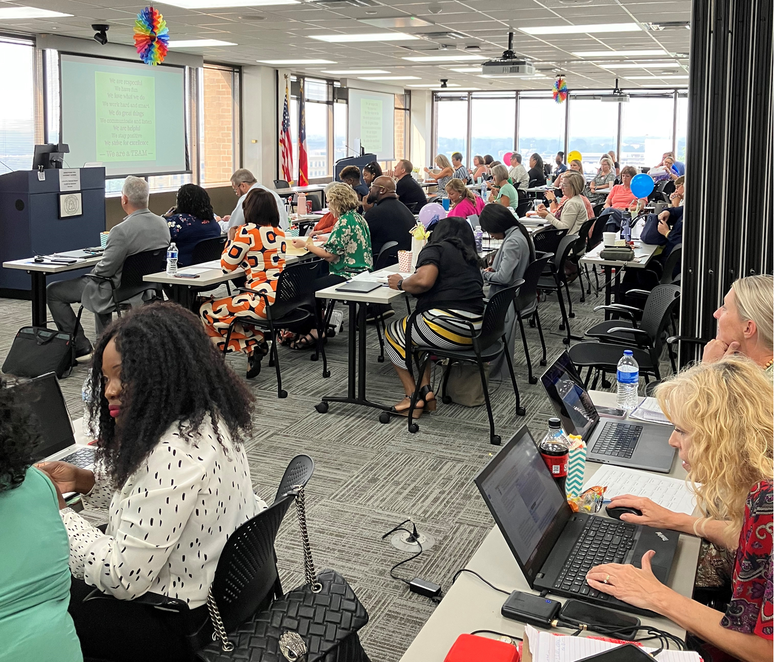
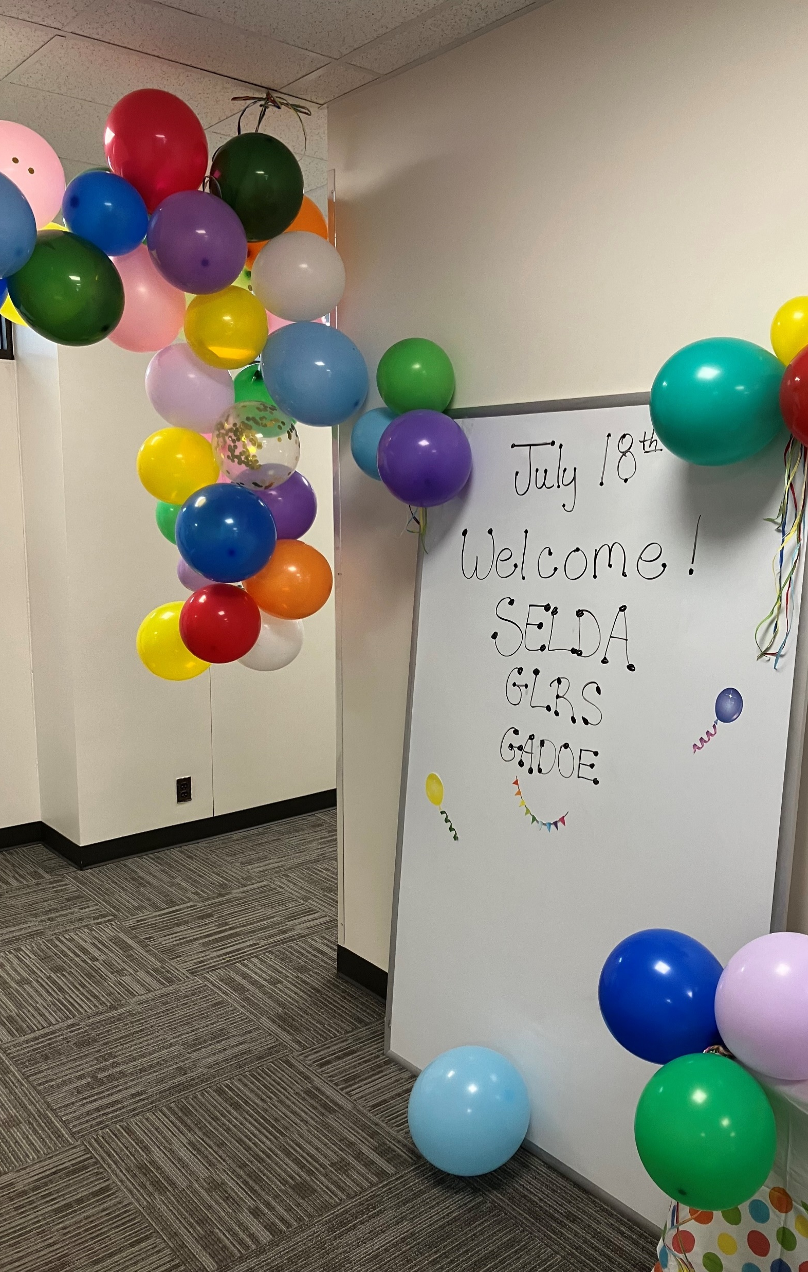
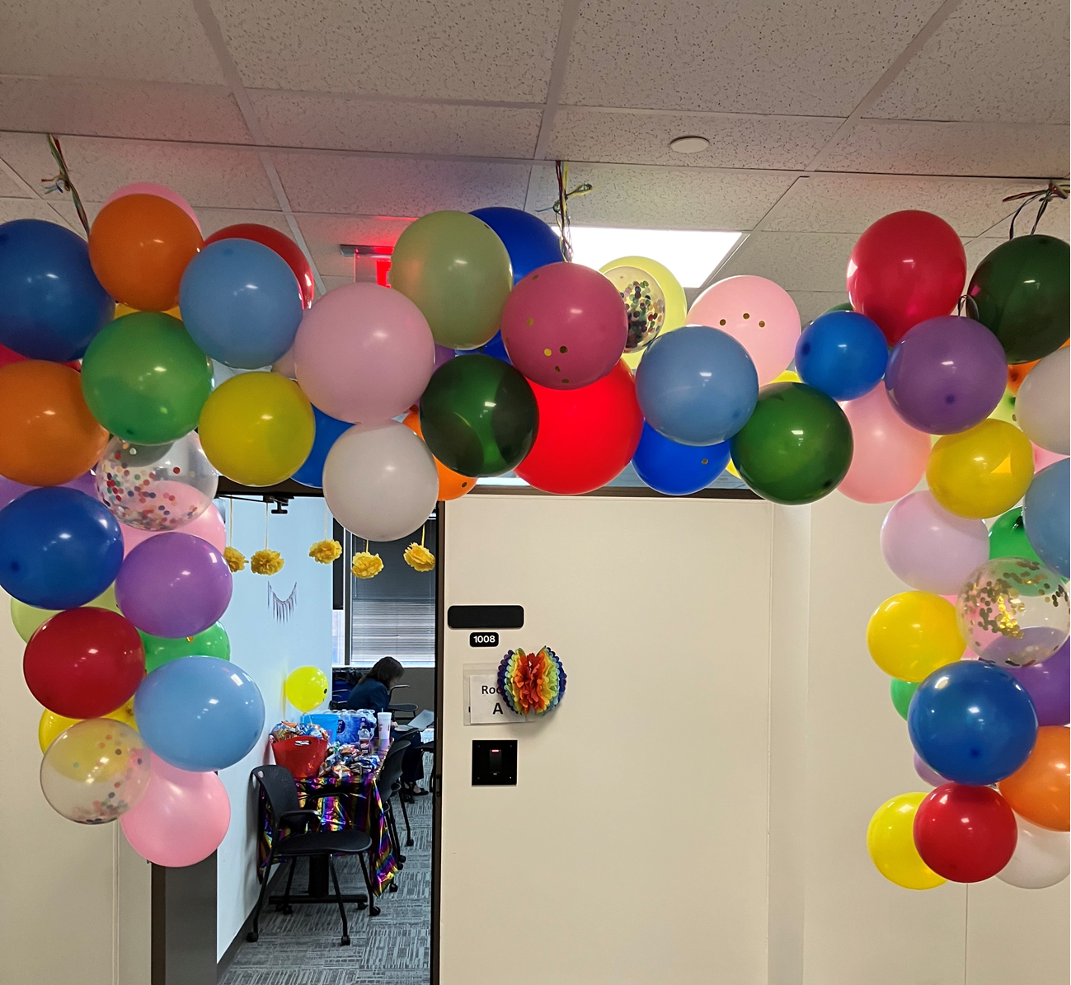
Join me in honoring our new directors
Special Thanks to G-CASE, Belinda Tiller, Lynn Holland, Elise James and Annette Murphy
SELDA

Slide 72
Shine Your Light #3

Slide 73
Contact Information
Wina Low, State Director
wlow@doe.k12.ga.us

