Slide 1
TRASH talk! Teaching Reading Adeptly, Systematically, and with Humor!
Lisa Kay Knight
G-CASE conference 2015

Slide 2
National Reading Panel Five domains of Reading
Phonemic awareness
Phonics
Fluency
Comprehension
Vocabulary

Slide 3
Domain 1: Phonemic Awareness
is the ability to hear, identify, and manipulate individual sounds-phonemes--in spoken words. Before children learn to read print, they need to become more aware of how the sounds in words work. They must understand that words are made up of speech sounds, or phonemes (the smallest parts of sound in a spoken word that make a difference in a word's meaning).

Slide 4
Phonemic Awareness
When using a poem, nursery rhyme or song for phonemic awareness you are not providing a written copy. Remember phonemic awareness is about the ability to recognize and manipulate sounds. A phoneme is a discrete sound.
Activity: Down by the Bay

Slide 5
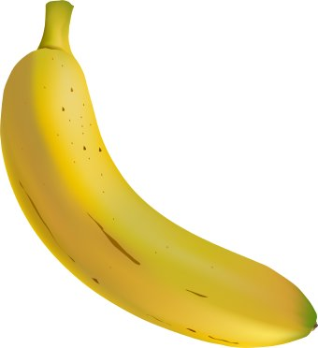
Phonemic Awareness
Activity: B- A- BA

Slide 6
Domain 2- Phonics
Phonics- the relationship between letters and sounds
A grapheme is the letter representation of that sound.
It can be:
one letter /b/=b
two letters /ch/=ch
three letters /spl/= spl
Let’s see what phonics we can pull out of this kid friendly poem…

Slide 7
Flying raisins are in the air, there are flying raisins everywhere
I see them flying all around, I see them landing on the ground
I wish they would just go away, but they’ll just come back another day
I see them flying in the sky, I see them getting in my pie
I see them walking on my cake, I see them in everything I make
I wish they would just go away, but they’ll just come back another day
I find them in my cookie dough, I don’t know why they just won’t go
I do not like them can’t you see, flying raisins are all over me
Then I saw the open box, sitting high upon the rack
I pulled it down then turned it around, it said “CAUTION” on the back
It said not for use in cooking, such as cookies, cakes or pies
I thought I bought a box of raisins, but they were laboratory flies
Flying Raisins by Roger Horsch

Slide 8
Phonics Quiz
How many letters or combinations of letters make the long o sound (as in "toe") in English?
What is a phoneme?
How many phonemes are there in the following words: cat, chat, fish, stick, blue?
What is the difference between a phoneme and a grapheme?
Which two words from the following list have the same vowel sound: kept, bag, weigh, head, be?
Identify the consonant blends in each of the following words: fist, slip, stride, shred, prod.

Slide 9
Quiz Answers
How many letters or combinations of letters make the long o sound (as in "toe") in English? O in go, o in slow, o in goat, o in stone, o in toe, ough in though, ew in sew, eau as in beau or chateau
What is a phoneme? Distinct unit of sound /ch/
How many phonemes are there in the following words: cat 3, chat 3, fish 3, stick 4, blue 3?
What is the difference between a phoneme and a grapheme? Phoneme is heard, grapheme is the combination of letters that make that sound (seen)

Slide 10
Quiz answers
Which two words from the following list have the same vowel sound: kept, bag, weigh, head, be?
Identify the consonant blends in each of the following words: fist, slip, stride, shred, prod.
What blends or phonics patterns did you elect to teach with your poem? Would you make any changes now?

Slide 11
Domain 3-Fluency
What is a fluent reader?
Fluent Readers read at an appropriate rate and tone to convey meaning to the listener. Faster is not always more fluent. Fluency can be measured in words per minute, but when you are listening for fluency, you are listening for accuracy, phrasing, smoothness and pace.
(for more information see the National Assessment of Educational Progress , or NAEP, oral reading fluency scale)

Slide 12
Decoding and ‘Swooping’
To improve students’ fluency, work on improving automaticity and phrasing.
Automaticity- the ability to see a word and instantly hear it in your head, and have an associated meaning
Phrasing- stringing words together in natural, meaning making phrases

Slide 13
Warning
When I am an old woman I shall wear purple With a red hat which doesn't go, and doesn't suit me.
And I shall spend my pension on brandy and summer gloves And satin sandals, and say we've no money for butter.
I shall sit down on the pavement when I'm tired And gobble up samples in shops and press alarm bells And run my stick along the public railings And make up for the sobriety of my youth.

Slide 14
I shall go out in my slippers in the rain And pick flowers in other people's gardens And learn to spit. You can wear terrible shirts and grow more fat And eat three pounds of sausages at a go Or only bread and pickle for a week And hoard pens and pencils and beermats and things in boxes. But now we must have clothes that keep us dry And pay our rent and not swear in the street And set a good example for the children. We must have friends to dinner and read the papers. But maybe I ought to practice a little now? So people who know me are not too shocked and surprised When suddenly I am old, and start to wear purple.
By Jenny Joseph

Slide 15
Fluency interventions
Beat my time!
Partner Reading
Reader’s Theater
Radio Reading

Slide 16
Why improve fluency? It’s a CCGPS standard.
➢ Fluency
ELACC5RF4: Read with sufficient accuracy and fluency to support comprehension.
a. Read on-level text with purpose and understanding.
b. Read on-level prose and poetry orally with accuracy, appropriate rate, and expression on successive readings.
c. Use context to confirm or self-correct word recognition and understanding, rereading as necessary.
Fluency is an appropriate goal for any grade level. It’s measurable, foundational and directly impacts
every academic area.

Slide 17
Domain 4- Comprehension-
Comprehension is the ability to construct meaning from text and understand the author’s intended message

Slide 18
It’s important to match the selection to the students….things to consider:
Interest level
Ability level
Socio Economic Status
Gender
Cultural or Regional considerations
Current events
Current interests

Slide 19
Comprehension
Interventions:
Paragraph Shrinking
Prediction
Visualization
Mindmaps

Slide 20
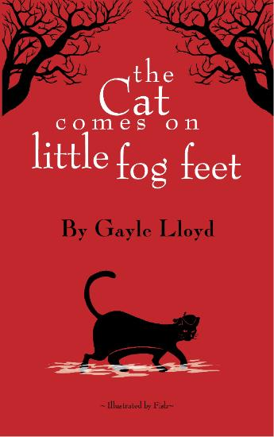
Comprehension- building a common knowledge base
Fog by Carl Sandburg
The fog comes on little cat feet. It sits looking over harbor and city on silent haunches and then moves on.
Famous poetry is often alluded to in other works.

Slide 21
What other standards can we teach while we are using this poem?
This ‘broad reading’ standard is found at every grade level; this example is from fifth grade.
ELACC5RL10: By the end of the year, read and comprehend literature, including stories, dramas, and poetry, at the high end of the grades 4-5 text complexity band independently and proficiently.

Slide 22
What other standards can we teach while we are using this poem?
The ‘craft and structure’ standards about vocabulary all include figurative language and tone…. What better than poetry to teach this?
ELACC8RL4: Determine the meaning of words and phrases as they are used in a text, including figurative and connotative meanings; analyze the impact of specific word choices on meaning and tone, including analogies or allusions to other texts.
ELACC7RL5: Analyze how a drama’s or poem’s form or structure (e.g., soliloquy, sonnet) contributes to its meaning.

Slide 23
What other standards can we teach while we are using this poem?
Writing standards:
ELACC7W3: d. Use precise words and phrases, relevant descriptive details, and sensory language to capture the action and convey experiences and events.
Speaking and Listening Standards:
ELACC6SL1: Engage effectively in a range of collaborative discussions (one-on-one, in groups, and teacher-led) with diverse partners on grade 6 topics, texts, and issues, building on others’ ideas and expressing their own clearly.

Slide 24
Comprehension
Mindmaps… such as Setting the Table
Best guess as to the setting
Title of poem, book, or selection
Clues for time
Clues for location

Slide 25
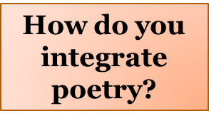
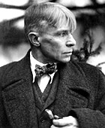
I WISH to God I never saw you, Mag. I wish you never quit your job and came along with me. I wish we never bought a license and a white dress For you to get married in the day we ran off to a minister And told him we would love each other and take care of each other Always and always long as the sun and the rain lasts anywhere. Yes, I'm wishing now you lived somewhere away from here And I was a bum on the bumpers a thousand miles away dead broke. I wish the kids had never come And rent and coal and clothes to pay for And a grocery man calling for cash, Every day cash for beans and prunes. I wish to God I never saw you, Mag. I wish to God the kids had never come.
Mag by Carl Sandburg

Slide 26
When I get to be a composer I'm gonna write me some music about Daybreak in Alabama And I'm gonna put the purtiest songs in it Rising out of the ground like a swamp mist And falling out of heaven like soft dew. I'm gonna put some tall tall trees in it And the scent of pine needles And the smell of red clay after rain And long red necks And poppy colored faces And big brown arms And the field daisy eyes Of black and white black white black people And I'm gonna put white hands And black hands and brown and yellow hands And red clay earth hands in it Touching everybody with kind fingers And touching each other natural as dew In that dawn of music when I Get to be a composer And write about daybreak In Alabama.
Langston Hughes
Daybreak in Alabama

Slide 27
[in Just-]
Just-
spring when the world is mud-
luscious the little
lame balloonman
whistles far and wee
and eddieandbill come
running from marbles and
piracies and it's
spring
when the world is puddle-wonderful
the queer
old balloonman whistles
far and wee
and bettyandisbel come dancing
from hop-scotch and jump-rope and
it's
spring
and
the
goat-footed
balloonMan whistles
far
and
wee
[in Just-]
By E. E. Cummings 1894–1962

Slide 28
Teach what you love. Love what you teach.
Fall in Reign
The dying leaves drop
Desultory
And fall into
A still small pool
Of fallen rain.
Youth
Amid the sea of yellow flowers
One proud violet stands alone
It caught my eye with a gleam of surprise
That one would dare to be blue
Where thousands of yellows
Surround
And
Confuse it.
l
one
l
I
-ness
Watching you eat Spaghetti
Two floppy fangs
Wiggle from the corners of your toothless smile
And around your mouth
Evidence of your debauchery.
My poetry… find a favorite author. It might be you.

Slide 29
Where can I find poetry for comprehension?
Poetry sites online:
www.poetryfoundation.org
www.poetry-archive.com
www.poetryfoundation.org
www.gigglepoetry.com
Google it!

Slide 30
Domain 5- Vocabulary
How familiar are you with this word?
Littoral
Analogous
clandestine

Slide 31
Vocabulary
littoral
1.of, relating to, or situated on the shore of the sea or a lake.
"the littoral states of the Indian Ocean"
noun
2.a region lying along a shore.
"irrigated regions of the Mediterranean littoral"

Slide 32
Vocabulary
analogous
Adjective
having analogy; corresponding in some particular:A brain and a computer are analogous.
clandestine
Adjective
characterized by, done in, or executed with secrecy or concealment, especially for purposes of subversion or deception-private or surreptitious

Slide 33
Domain 5- Vocabulary
Intentionally embedding vocabulary lessons into read- alouds is research supported.
Small group word work with meaning making conversations from Tier 2 words found in read alouds.
Build conceptual understandings of words and how they are related rather than definitions in isolation
Both EXPLICIT and EMBEDDED

Slide 34
National Reading Panel-
The National Reading Panel’s analysis, completed in 2000, found that reading instruction should include:
Phonemic awareness—the knowledge that spoken words can be broken apart into smaller segments of sound known as phonemes.
Phonics—the knowledge that letters of the alphabet represent phonemes, and that these sounds are blended together to form written words. Readers who are skilled in phonics can sound out words they haven't seen before, without first having to memorize them.
Fluency—the ability to recognize words easily, read with greater speed, accuracy, and expression, and to better understand what is read. Children gain fluency by practicing reading until the process becomes automatic; guided oral repeated reading is one approach to helping children become fluent readers.
Guided oral reading—reading out loud while getting guidance and feedback from skilled readers. The combination of practice and feedback promotes reading fluency.
Teaching vocabulary words—teaching new words, either as they appear in text, or by introducing new words separately. This type of instruction also aids reading ability.
Reading comprehension strategies—techniques for helping individuals to understand what they read. Such techniques involve having students summarize what they've read, to gain a better understanding of the material.

Slide 35
Websites
www.begintoread.com
www.pbs.org/parents/education/reading-language/
www.readingdoctor.com.au/phonemes-graphemes-letters-word-burger/
www.readingrockets.org/strategies
www.discoveryeducation.com/
www.dailyteachingtools.com/language-arts-graphic-organizers.html
www.readworks.org

Slide 36
Other resources:
The Fluent Reader: Oral Reading Strategies for Building Word Recognition, Fluency and Comprehension by Timothy Rasinki
Evidence-Based Instruction in Reading: Professional Development Guide to Fluency by Nancy Padak and Timothy Rasinki
www.readwritethink.org

