Slide 1
A System of Care
Keeping Kids
IN their Homes, Schools and Communities
Keeping Kids
OUT of Detention and Foster Care

Slide 2
Northwest Georgia System of Care
Building a System of Care

Slide 3
NW GA SOC
A Collective Impact Initiative
COMMON AGENDA – shared vision for change
SHARED MEASUREMENT – collecting data and
measuring results consistently
MUTUALLY REINFORCING ACTIVITIES -
differentiated while still being coordinated
CONTINUOUS COMMUNICATION – consistent and
open
BACKBONE SUPPORT – coordination of participating
organizations and agencies

Slide 4
History
1999- Parallel regional meetings among non-judicial partners concerning MATCH kids
2002- 5 Judges start meeting Why?
2003- Merger of Judges and other partners – McArthur Initiative – No $$$ but ongoing collaboration begins
2003 - Judges invited & 5 made leadership commitment
Notes:
Judge Tilley, Margaret Cawood

Slide 5
History
2005 applied for SAMHSA Grant – Denied –Not quite ready…
2008 applied again – Accepted!!
Regional Behavioral Health – Repurposed C&A funds-care coordination services for 8 counties.
Region of Hope
Notes:
Judge Tilley, Margaret Cawood

Slide 6
Membership
Notes:
Judge Tilley, Margaret Cawood

Slide 7
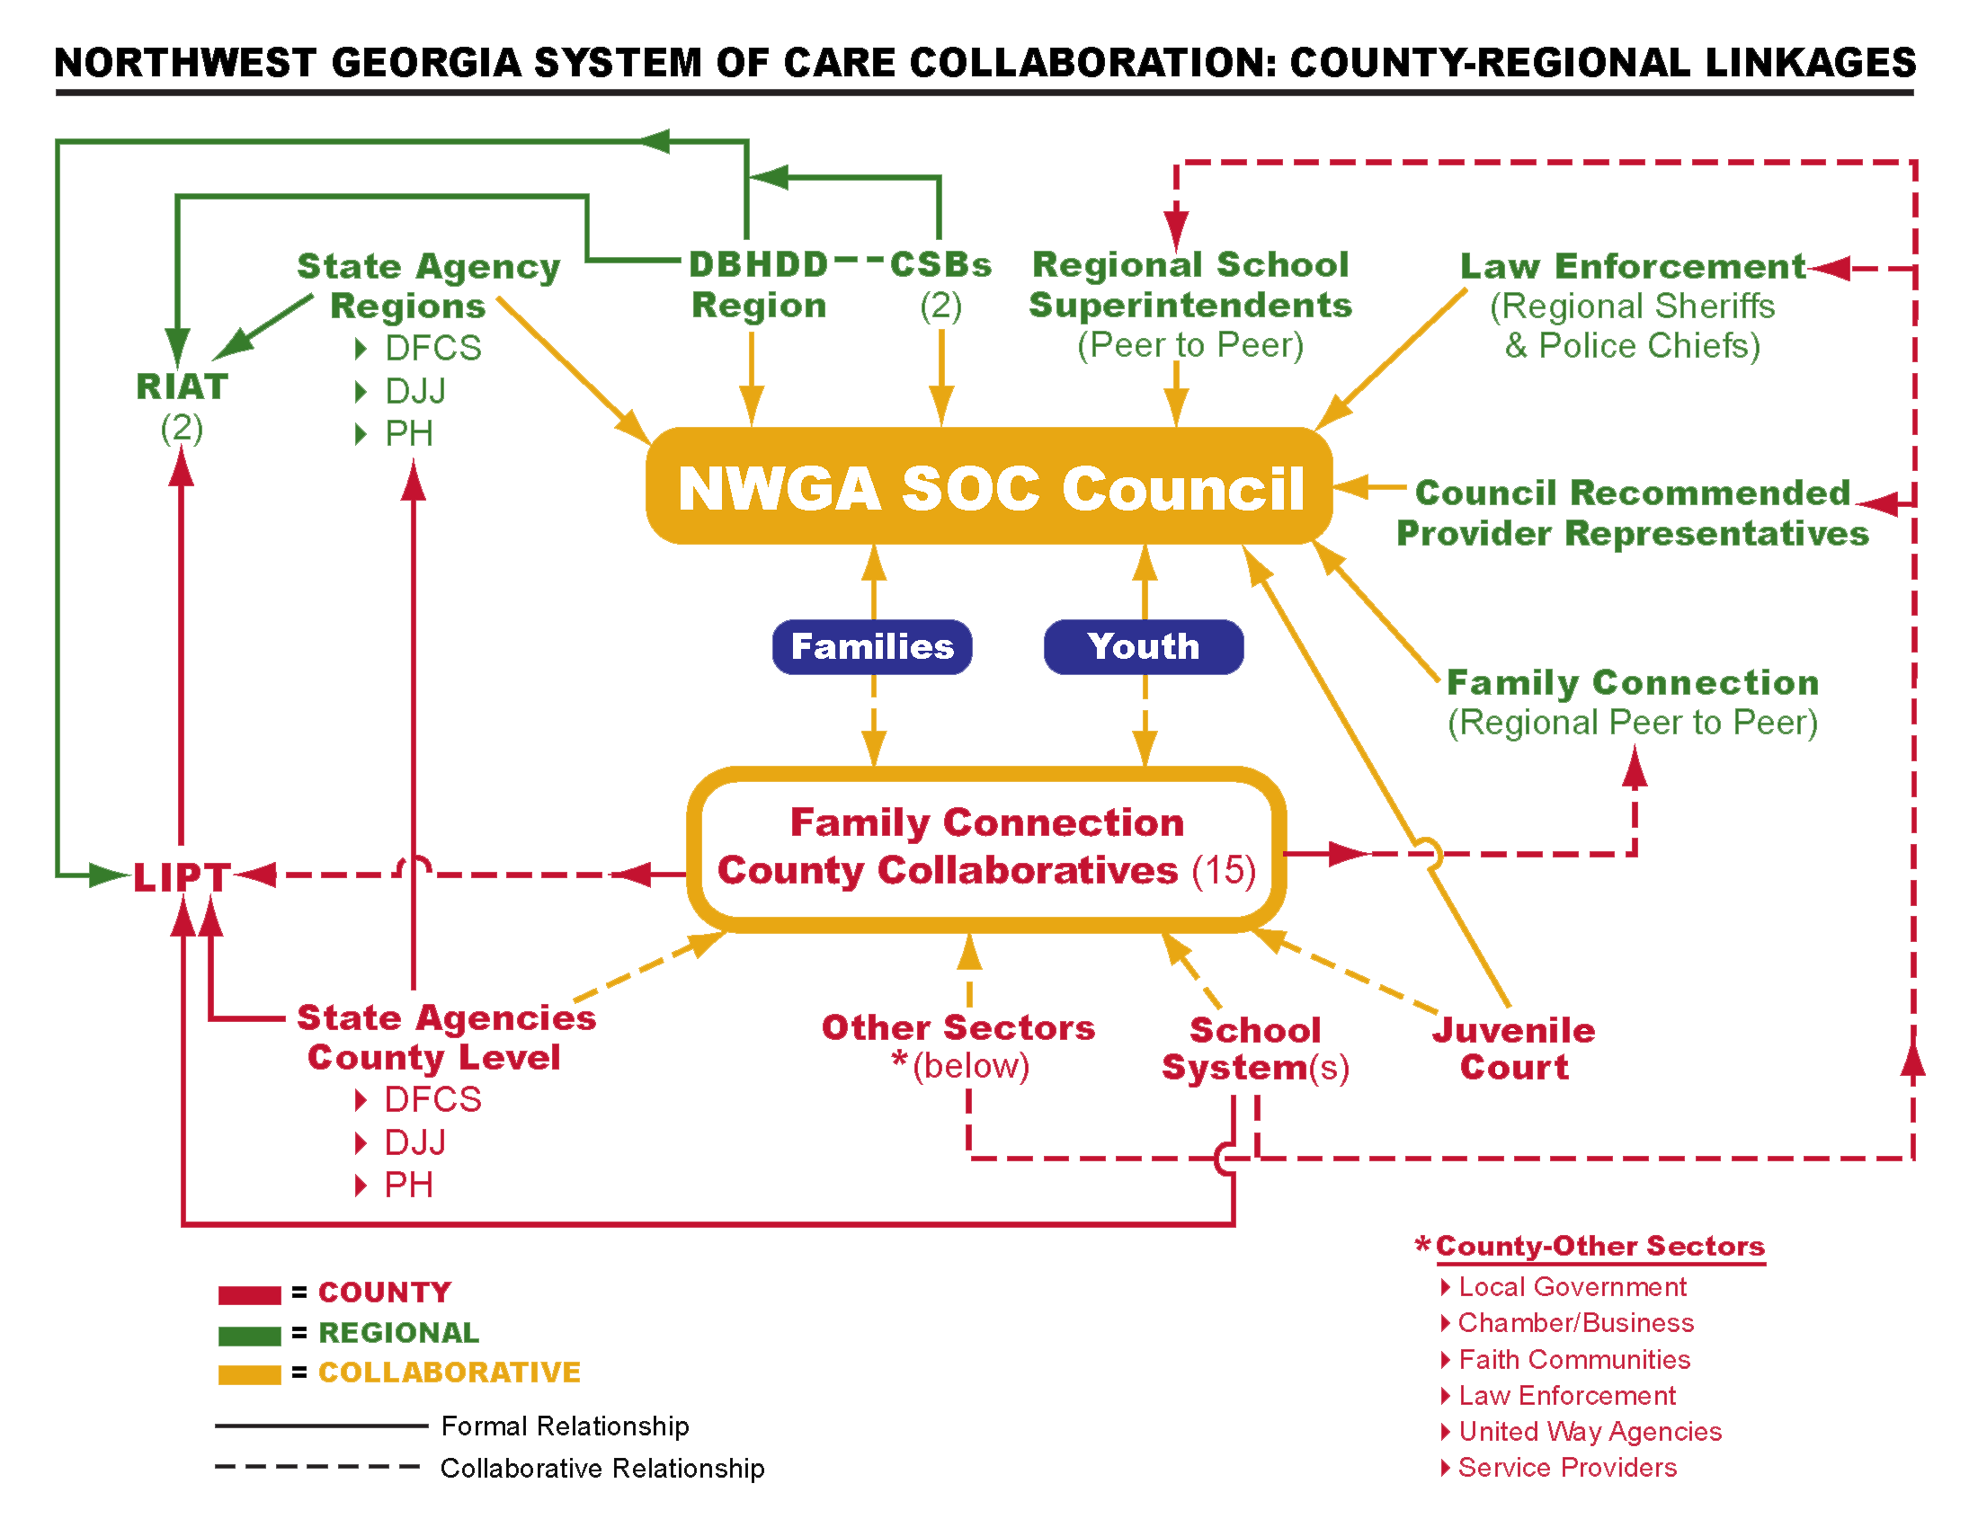
County-Regional Linkages
Notes:
Beth Dague

Slide 8
Plans and Initiatives
Notes:
Beth Dague

Slide 9
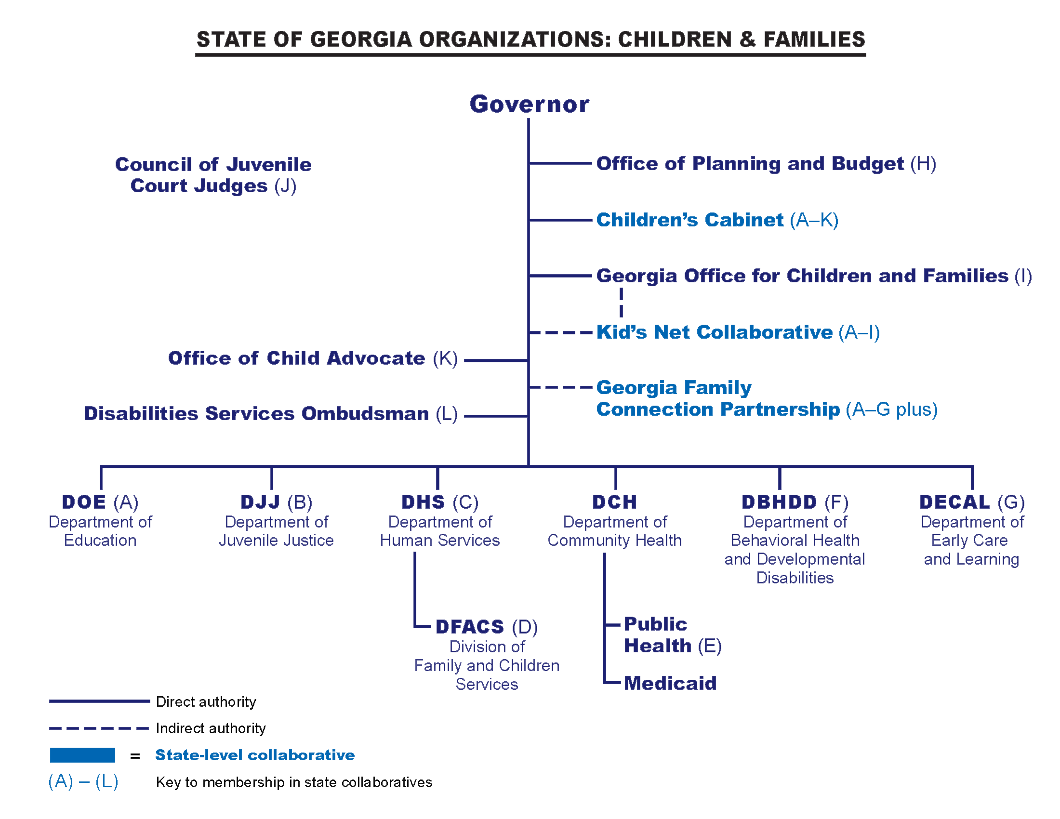
State Organizations
Notes:
Charles Fetner

Slide 10
Parents as Partners
Family Navigators
Building parent to parent connections as part of the package for all families in a system of care setting
Foster the development and effectiveness of parents as helpers in the system of care
Change the perception of families from recipients of service to partners at all levels of system operation
Training in development to certify Family Navigators as Medicaid-billable Peer Supports
Notes:
Ken Parks

Slide 11
First Steps
MAYSI – Screening of juvenile justice youth
McArthur Regional site
DFCS/DJJ – 25 Kid Pilot
ICAN – youth in detention- link to physical/behavioral health services
Regional DFCS & DJJ Memorandum of Agreement
KidsNet Pilot Site
Notes:
Margaret Cawood

Slide 12
Connecting the Populations of Focus
…the wise man commented, "But, young man, do you not realize that there are miles and miles of beach and there are starfish all along every mile? You can't possibly make a difference!"
At this, the young man bent down, picked up yet another starfish, and threw it into the ocean. As it met the water, he said, "It made a difference for that one.“
The Starfish Story
adapted from The Star Thrower
by Loren Eiseley
RIAT
DJJ
LIPT
Public
Health
Mental
Health
Juvenile
Court
Voc.
Rehab.
DFCS
START
Education
Notes:
Margaret Cawood

Slide 13
Population of Focus: Youth scoring high on DJJ Risk Assessment
These at-risk youth will receive Wraparound Services from LM CME
Generate sustainability funds through billing
$54.20/day per child, averaging $20,000/month
System Transformation
Wraparound Training
Coaching
Notes:
Margaret Cawood

Slide 14
Division of Family &
Children Services
Fiscal contribution to Regional Council (approx. $125,000) currently in process
System Transformation
Infusion of Wraparound Principles
Bartow, Floyd, & Polk DFCS & START Staff received Wrap Training from Neil Brown
Strengthening and deepening DFCS partnerships across systems
START
Notes:
Ross Collins, Ken Parks

Slide 15
Governor’s Office for
Children and Families
Early Childhood Grant
Assessment of resources/risks/gaps
Coordination/linkage/referral services
Education of agencies/organizations
Resource Development
Regional web-linked resource directory
Notes:
Margaret Bean

Slide 16
Network Expansion
Expanding the Network
Growing the provider network regionally and offering technical assistance to other regions
Deepening partnerships
Deepen partnership with education
Ensure deeper partnership with Public Health, in light of healthcare reform, as well as Early Childcare Initiative
Strengthen relationships with Faith-based partners
State legislators
Community leadership
Notes:
Ken Parks

Slide 17
Evaluation
Data-driven
Cost benefit analysis
Notes:
Ken Parks
Touching on evaluation briefly, but transitioning into What Do We Need as quickly as possible

Slide 18
Why do we need to have these
conversations?

Slide 19
They are all OUR kids
We all face similar challenges
School to Prison Pipeline
Together we can make a difference

Slide 20
Other Questions or Comments?

Slide 21
Velma Cowen Tilley
Judge
Bartow County Juvenile Court
vctilley1@yahoo.com

